Slide 1
Module introduction
INF08104: Database Systems
Brian Davison, 2014/15

Slide 2
Agenda
What is so important about databases?
What is a database?
Module structure

Slide 3
Why you need to know about databases
Technical
Business
Speed
Maintainability
Security
Standardisation
Improved data management
E-business
Data as a product
Employability

Slide 4
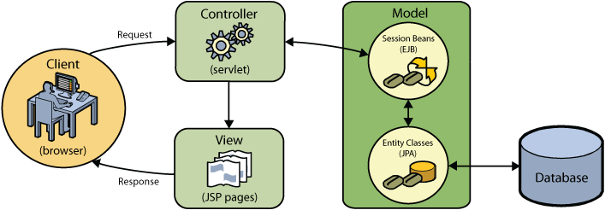
What is a database?
An organized collection of data
Wikipedia
A shared collection of logically related data, and a description of this data, designed to meet the information needs of an organisation
Connolly & Begg
A component in a larger system
http://netbeans.org

Slide 5
A little bit of history
Pre-1950: Negligible electronic data storage
1950 – 1970: Application of computing to standard data problems
1970: Edgar Codd, A Relational Model of Data for Large Shared Data Banks
1970 – 1985: Massive growth in relational database use
1985 – 2014: Maturity of platforms, data warehouses, OLAP
2014: Big Data, NewSQL, NoSQL

Slide 6
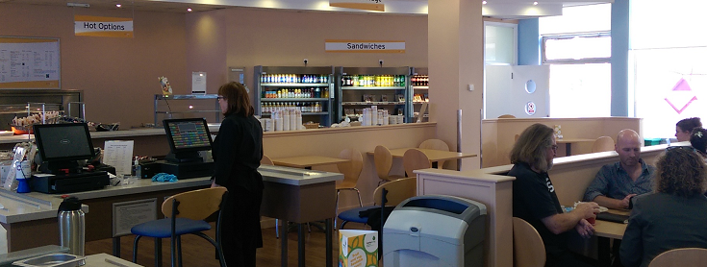
A model of the real world…
Suppliers
Stock
Products
Hours
Menu
Places
Sales
Staff
Customers
Rota
Salary
Purchases
Offers

Slide 7
The database approach
Table name = EMPLOYEE
Schema
Name | Address | Date of Birth | Salary
Jim Smith | 1 Apple Lane | 1/3/1991 | 11000
Jon Greg | 5 Pear St | 7/9/1992 | 13000
Bob Roberts | 2 Plum Road | 3/2/1990 | 12000
Data

Slide 8
Database advantages
Data independence (more about this later…)
Multi-user access
Data integration
Data integrity
Enforcement of standards
Security
Performance

Slide 9
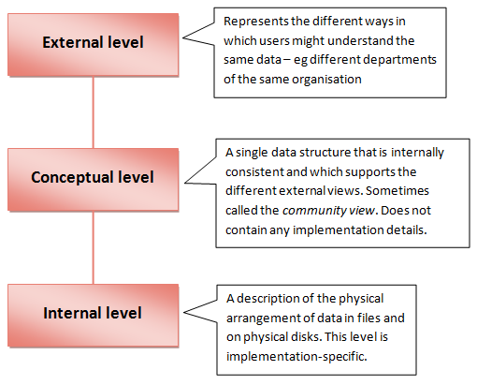
ANSI-SPARC 3-level architecture

Slide 10
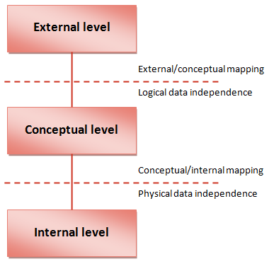
Data independence

Slide 11
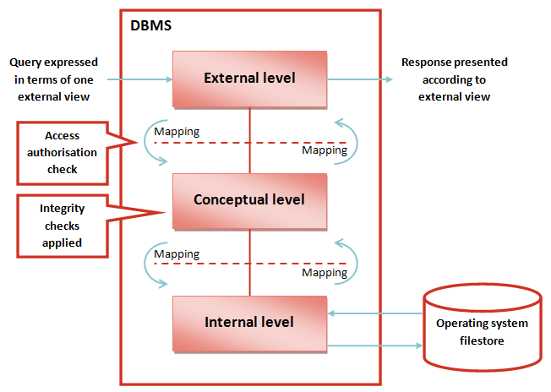
The DBMS

Slide 12
Data model components
Component | Description | Examples
Entities | The important things in the real world that need to be modelled | People, places, objects, events, etc.
Attributes | Individual items of data associated with an entity | Name, national insurance number, weight, date of manufacture
Relationships | Ways in which entities are connected | A is part of B, A lives in B, A produces B, A takes place in B, etc.
Constraints | Rules which place limits on the data that is allowed | Every A must have a B, Only future dates are allowed, etc.

Slide 13
Data integrity
Data must be correct and complete
Type checks
e.g. ensuring a numeric field is numeric and not a character
Redundancy checks
direct or indirect - this check may not be automatic and may have to be added by the database designer
Range checks
e.g. to ensure a data item value falls within a specified range of values, such as checking dates so that say (age > 15 AND age < 70).
Comparison checks
in this check a function of a set of data item values is compared against a function of another set of data item values. For example, the max salary for a given set of employees must be less than the min salary for the set of employees on a higher salary scale.

Slide 14
Roles
End users
Application programmers
Database administrator

Slide 15
Module structure
Theory
Standard architecture, security, concurrency
Design
Analysis, schema definition, diagrams
Use
SQL, embedded SQL
Administration
Backup & recovery, user management, scripting

Slide 16
Assessment
Coursework 50%
Details in week 4
Database creation
SQL queries
Deadline week 9 – 1200, Friday 7th November
Exam 50%
Theory
SQL queries

Slide 17
Feedback from previous years
I was pleased with my overall performance with the coursework – it was a lot of work but it was rewarding to work on a long, challenging piece of work to good success
This was a challenging module that was extremely rewarding, very intense and I am now very confident with SQL and working with databases.

Slide 18

Short break

